Slide 1
CoPTA: Contiguous Pattern Speculating TLB Architecture
Yichen Yang, Haojie Ye, Yuhan Chen, Xueyang Liu, Nishil Talati,Xin He, Trevor Mudge, and Ronald Dreslinski
University of Michigan, Ann Arbor MI 48109, USA
07/05/2020

Slide 2
Motivation
TLB is used as a cache for speeding up the address translation.
Big-data workloads are stressing the TLB because of its limited size and complex PTW procedure.
A significant portion is spent on the PTW.
More than 25% in some benchmarks.
Processor time breakdown for different benchmarks
07/05/2020
SAMOS XX 2020

Slide 3
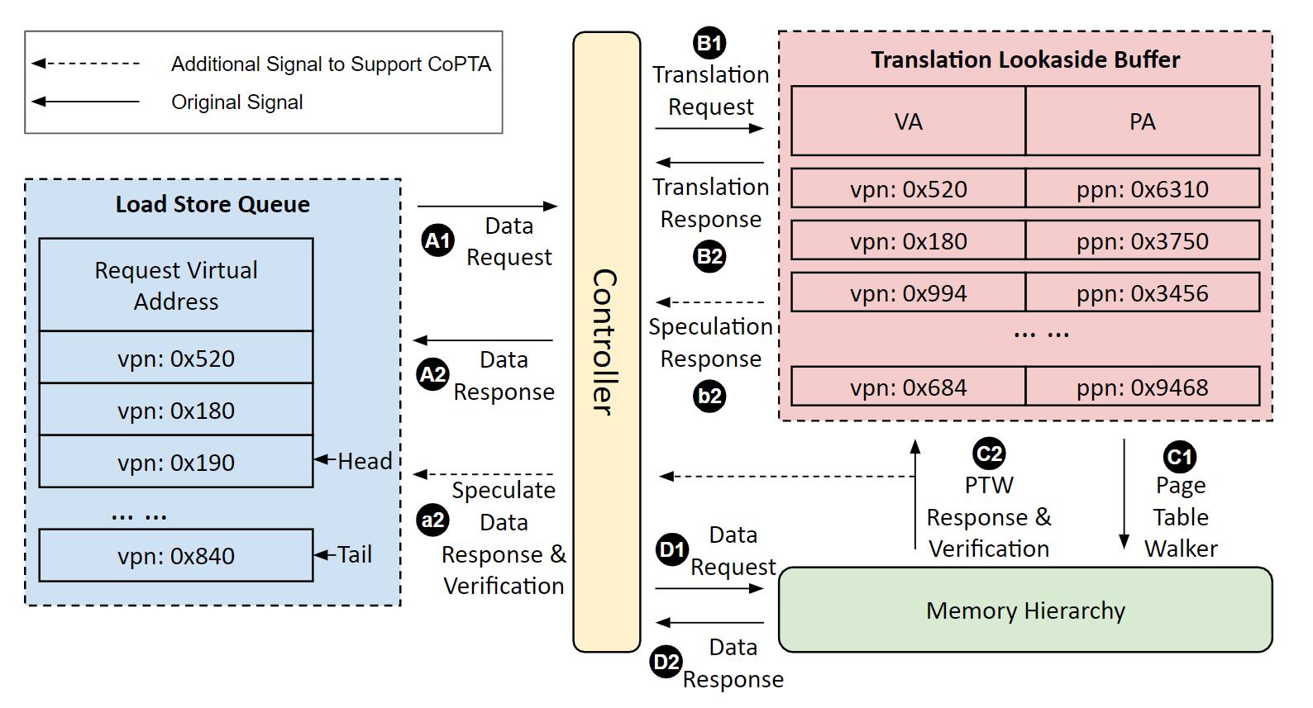
Detailed Architecture
Modify TLB and LSQ to support TLB speculation.
TLB can send speculated address translation result back when it is a miss to TLB.
Parallelize the PTW procedure with data request.
The pipeline can execute succeeding instructions without stalling on the PTW.
Squash the pipeline similar to branch miss-prediction if the speculation is incorrect.
Overview of TLB speculation architecture
07/05/2020
SAMOS XX 2020

Slide 4
Result - Memory Contiguity
Continuous pattern prediction relies on the memory allocation contiguity.
Under normal defrag and THS enabled configuration, the system can automatically trigger memory compaction.
Left: normal defrag + THS disable; Middle: normal defrag + THS enabled; Right: disable defrag + THS enabled
07/05/2020
SAMOS XX 2020

Slide 5
Result - CoPTA Performance
Average prediction accuracy: 82%
Average end-to-end performance improvement: 16%
CoPTA Prediction Accuracy
Overall Performance Improvement
07/05/2020
SAMOS XX 2020

