Slide 1
EM Talk
Trevor Mudge
June, 2014
Notes:
I’m very thrilled to receive this award. Not much for awards but this is different because it represents the community that I worked in for nearly 30 years.
It would not have been possible without Jan my wife and scuba diving partner who has put up with me since grad school at Illinois—it’s been an interesting journey. Thanks
these
Also my work is really a reflection of collaborations with about 50 past PhD and the current 8 or so. In many cases it has led to lifelong friendships. It’s been and continues to be a very rewarding experience. I’d like to thank them too.
Finally, I’ve been fortunate work with some very talented people in the past and present: Dick V Ron L Dan A Rich B Karem S and more recently Kris F David B Ron D Scott M and Tom W

Slide 2
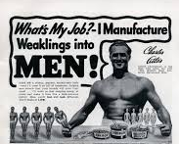
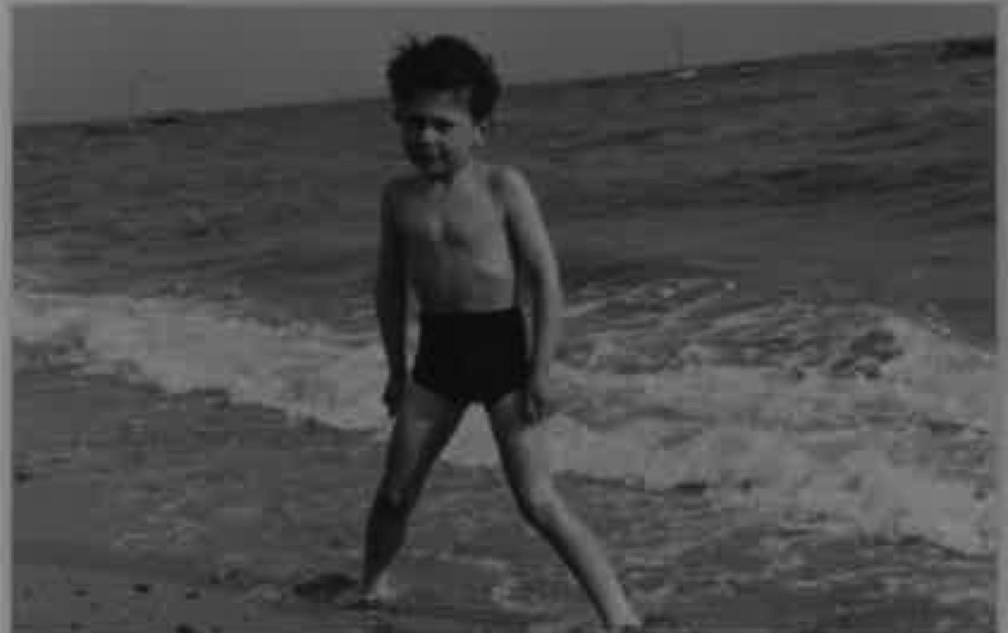

What I Really Wanted To Be
I wanted to be like
Charles Atlas
I sent in my application photo

Slide 3
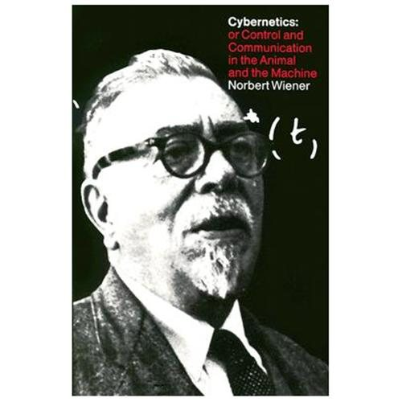
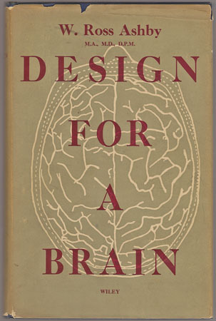
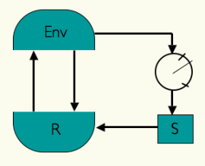
Applied Physics and Mathematics
U/G degree at Reading England in 1969—now the heartland of high tech in UK (since I left)
Applied Physics and Math(s) dept—Cybernetics
focus modeled on Norbert Wiener’s book
  Their agenda was wide ranging:
    social sciences
    economic systems
    biology human brains
    as well as man-made machines
  It was a highly ambitious agenda,
  but the outcome left something to be desired
Conflated control theory with AI—my opinion
  Got interested in AI—McCulloch-Pitts Neurons
Notes:
As math and phy major I knew the difference between energy and power – and QM
Cybernetics is heavy on control theory
MCP was forerunner of perceptions neural nets and other anthropomorphic ideas
Dave always plotted 1/x when I thought x

Slide 4

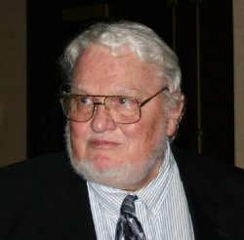
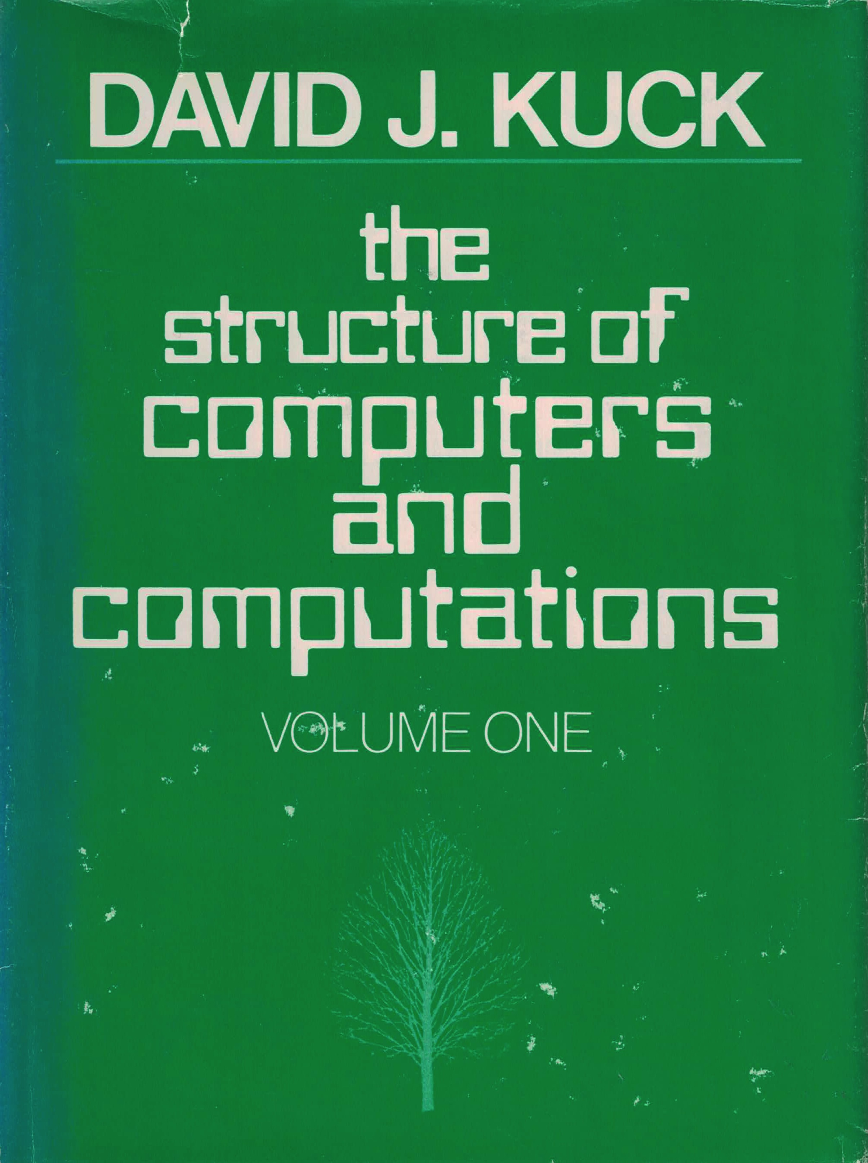

Graduate School at Illinois
ESU scholarship—typically British it had no $$ attached
  Planned to work in Heinz von Foerser’s Biological Computing Lab
Golden age in the US
Worked in DCL—the Digital Computer Lab at Illinois
  A pioneer in building experimental computers
  Remarkable infrastructure for building electronic systems
  Ted Poppelbaum (MS advisor)—first computer book with
  several chapters on QM
  Developed many pioneering computers—ORDVAC / Illiac 2 / 3 / 4
  Illiac 3 was one of the first pattern recognition machines—Bruce McCormick
  Illiac 4 defined SIMD—Dan Slotnick
  Illinois has gone on from strength to strength
Failed my computer architecture class
Many early machines were asynchronous
  Illiac 2 and 3, for example
  Thesis on Asynchronous synthesizable hardware design
  language (1977—Gerry Metze advisor)
  Led me to dataflow computers
Notes:
Where’s the Bio computer
The ORDVAC or Ordnance Discrete Variable Automatic Computer, an early computer built by the University of Illinois 1951
Anthroposophical Society and a School of Spiritual Science == Ted Popplebaum’s Dad in Switzerland
Illiac 2 and 3 async Was Ordvac?
IIliac 4 30 million = 180 million today Solomon was an earlier idea
Many years before Verilog etc.
Gerrry Post Algerbras asynch self checking checkers etc

Slide 5
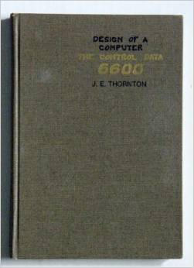
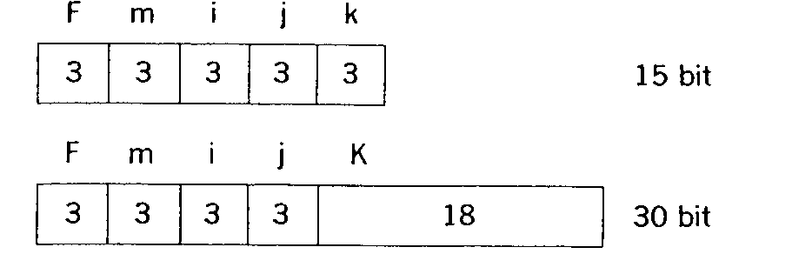
Michigan 1977
I was not yet willing to give up asynchronous
Gravitated to Jack Dennis’ work at MIT
  His group used the same composable asynchronous modules
  for design—leads to dataflow because both event driven
  I had done something less ambitious—Tomasulo’s algorithm
  An elegant implementation of the CDC 6600 stuntbox
  (scoreboard)
  Jim Thornton’s paper on considerations for the 6600 design
    Why fixed fields in the ISA definition?
    End of technology improvements so
    we’ll have to rely on parallelism—1965
    Fixed fields are easy to decode
About that time I was intrigued with Bob Keller’s paper on lookahead processors
    First clear analysis of lookahead
    It gave me ideas for removing the associative search from forwarding
Developed an interest in high performance microarchitecture
Notes:
6600 was in 1965
Keller was an asynch person too
Keller at Harvey Mudd
I solved one of his problems of sending results to consumers (regs and ALUs) in Tomasulos
I had a wide range of interests – I’ll focus on computer arch etc

Slide 6
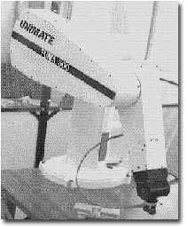
1980’s—Intel 432 and Robots
Programmed a robot to performing pick and place
Controlled by an Intel 432 programmed in Ada
Two wrongs make an even bigger wrong
Intel 432 was a heroic attempt to kill the x86
Reminiscent of
the Itanium
Notes:
Unimate robot
Invented computer vision algs to make it see
This paper identified the problems.
"Object-based computer architectures", T. Mudge, G. Buzzard, D. Verhaeghe, J. Hill, D. Winsor. The 1983 Conference on Information Sciences and Systems, The Johns Hopkins University. March, 1983. pp. 733-741. 6 levels of indirection
To access a 32b integer
Capabilities may still be a good thing.

Slide 7
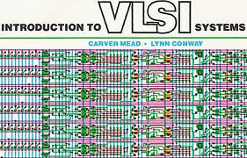
1980’s—VLSI era
Mead and Conway 1979
Started the Michigan version 1980
with several other faculty
Bought three DEC VAX 11/780s
NSF and DARPA and MOSIS
made it possible to teach classes and have students produce
chips—a revolution
EDA tools created in academia—Magic
EDA emerged as a discipline
At Michigan we transitioned to commercial tools—Mentor
Back to building chips—always thought it’s important to build things
Notes:
MPWs
Got me back to building chips or at least working with people who I could convince to build chips for me later

Slide 8
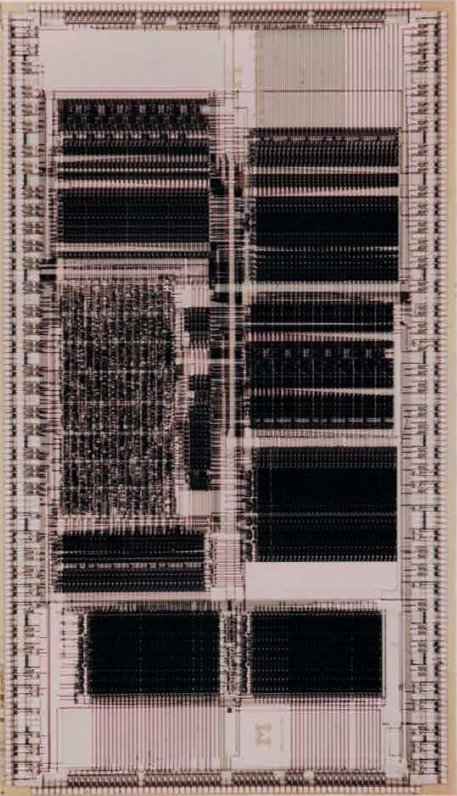
1990’s—Gallium Arsenide Computers
Why?
Pro
  Much higher electron mobility than Si—faster circuits
  Operated at 2V—missed the power story!
Con
  No design libraries—we made our own
  No MOSIS—we used Motorola’s fab
Led to “deep” pipelines—12 or so stages
Aurora—160,000 tr / 24W / 100-200 Mhz /1992 operational
  Final report in ISSCC 1993
DEC Alpha 20164 September 1994 150 MHz, later 200 MHz
  Production part in Si vs. prototype without memory interface among other “details”
Follow on—Aurora 2 used complementary GaAs
  Classic second project failure—too ambitious
Notes:
Some electronic properties of gallium arsenide are superior to those of silicon. It has a higher saturated electron velocity and higher electron mobility, allowing gallium arsenide transistors to function at frequencies in excess of 250 GH
Alpha Digital's 1.0-micrometre (µm) CMOS-3 process

Slide 9
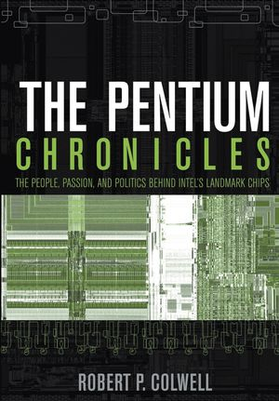
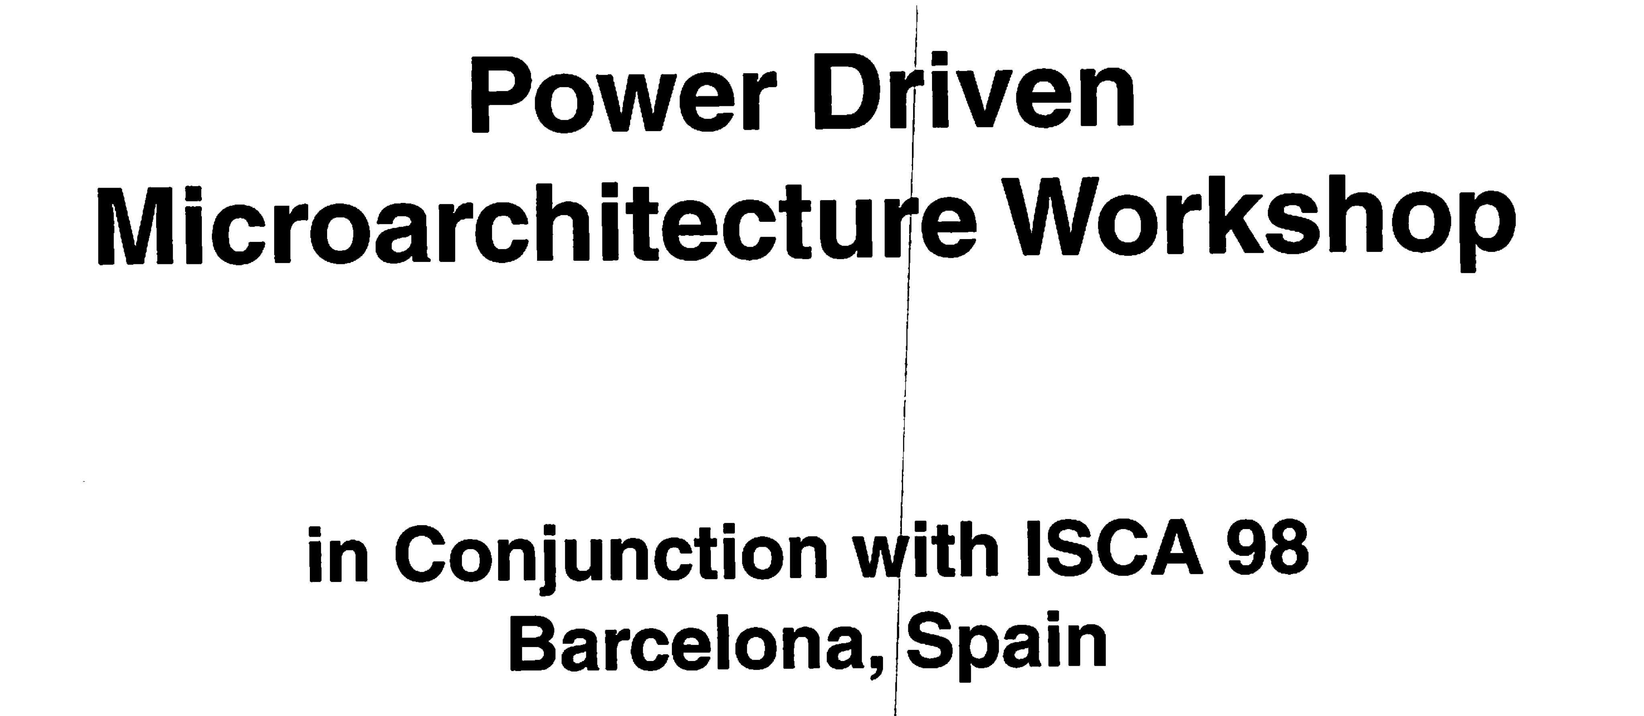
Mid-1990’s—Energy Aware Computing
Impetus from Bob Colwell—Intel’s Chief Architect
for the P6
Organized an ISCA workshop in 1998
with Dirk Grunwald & Bobbie Manne
Sabbatical in 2000 at ARM Cambridge
  Mike Muller was the catalyst—he hired
  Krisztián Flautner
Opened up a different perspective on
Computer Architecture
Power: A First-Class Constraint
  Several research “communities” had already
  got the story—ISLPED / CODES / CASES /…
  DSP / SoC community
Notes:
Bob had become very aware of power issues
Jim Smith said go to ARM
new model and Intel missed the boat
Creative destruction (German: schöpferische Zerstörung), sometimes known as Schumpeter's gale, is a term in economics which has since the 1950s become most readily identified with the Austrian American economist Joseph Schumpeter's[1] theory of economic innovation and business cycle.
Creative destruction describes the "process of industrial mutation that incessantly revolut

Slide 10
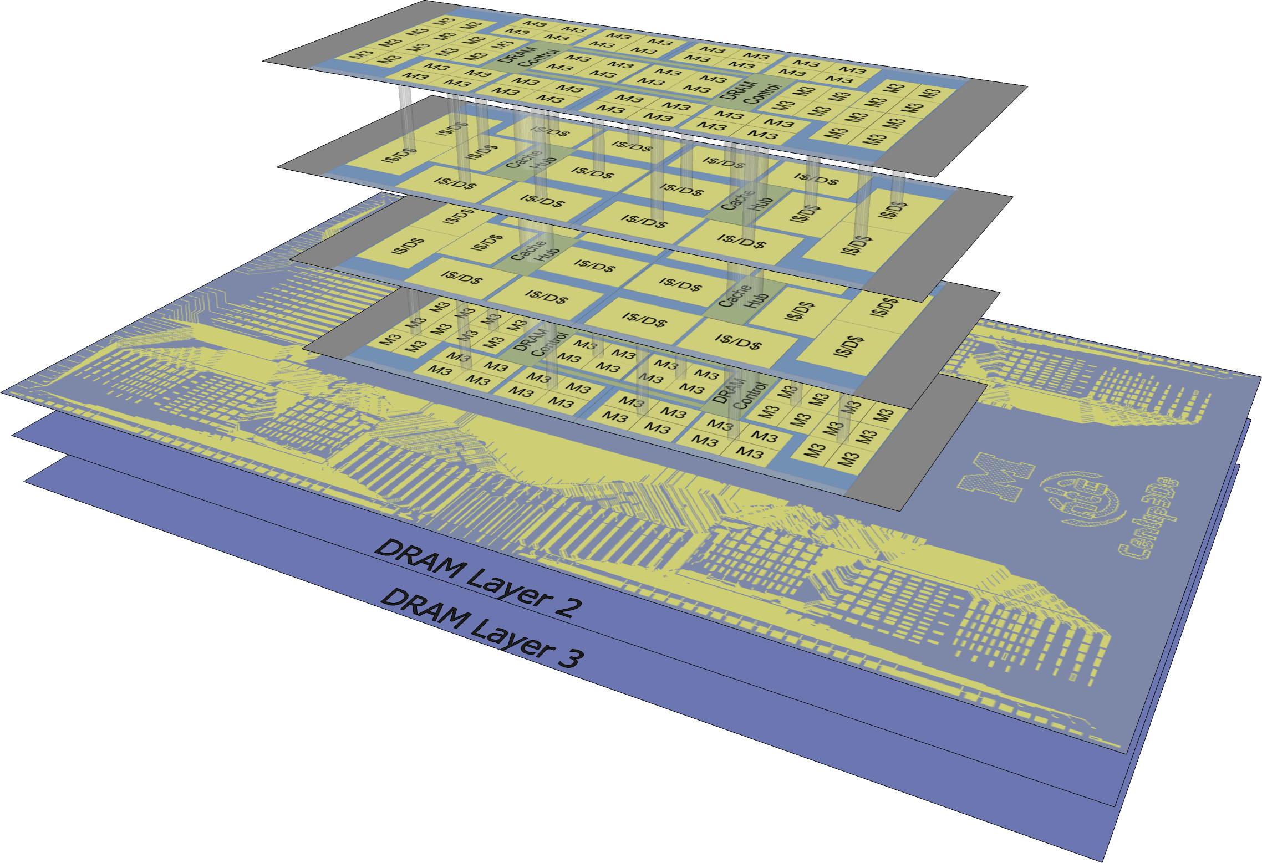
The Noughties—Energy Aware and 3D
Low power memories—SRAM and recently DRAM (2001—present)
Continued to fab things—students did the heavy lifting!
Razor chips—with David Blaauw and Todd Austin (2003—present)
  started as a low power story, but a variance tolerance story too
Programmable base-band processor—“mobile supercomputer” (2005—present)
3D as an aid to reducing power—PICOSERVER with Steve Reinhardt (2003)
Low voltage operation—NTC with Ron Dreslinski
and David Blaauw and Dennis Sylvester
3D + NTC = Centip3De with Ron Dreslinski
and David Blaauw (2011-3)
I believe that only by fabrication and experiment
can you fully understand the issues
Aristotle's theory that a heavier object falls faster than a lighter one could have been disproved by experiment
Notes:
Need 40% improvement to sell and idea to product groups
Men have more teeth than woment

Slide 11
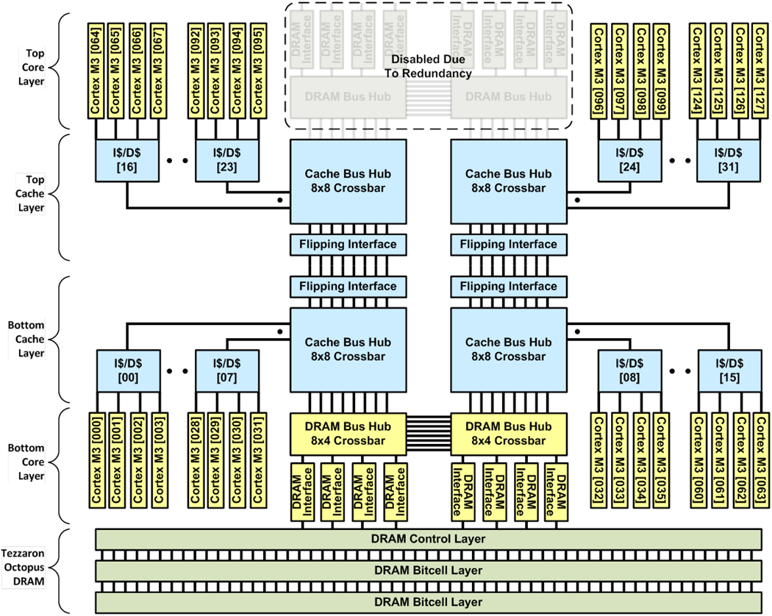
Centip3De System Overview
7-Layer NTC
system
2-Layer system
completed
fabrication
with measured
results
Full 7-layer system
expected
End of 2012
Measured

Slide 12
Centip3De System Overview
Cluster architecture
  4 Cores/cluster
  1kB I$, 8kB D$
  Local clock controller
  operates cores
  90˚ Out-of-phase
  1591 F2F connections
  per cluster
Organized into layer
pairs (cache⬄core)
  Minimizes routing
  Up to two pairs
  16 clusters per pair
  Cores have only vertical interconnections
Cluster
x32

Slide 13
Centip3De System Overview
Bus interconnect
architecture
  Up to 500 MHz
  9-11 cycle latency
  1-3 core cycles
8 lanes, each 128b
  One per DRAM
  interface
  Each cluster connects
  to all eight
  1024b total
Vertically connected
through all four layers
  Flipping interface enables 128-core system
Bus
System

Slide 14
Centip3De System Overview
3D-Stacked DRAM
  Tezzaron Octopus
1 control layer
  130nm CMOS
1 Gb bitcell layers
  Up to two layers
  DRAM process
8x 128b DDR2
interfaces
  Operated at bus frequency (up to 500 MHz)
DRAM System

Slide 15
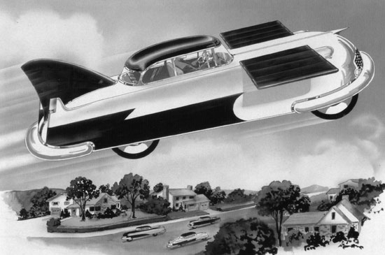
Where are we headed?
"Prediction is very difficult, especially if it's about the future.” –Nils Bohr
Corollary: And that’s why smart proposal writers have usually done most of the research they claim they will do in the proposal
Who would have predicted the personal computer in the 1950’s
  Computers in the future may weigh no more than 1.5 tons—TJ Watson (1874 – 1956)
Or cell phones ..
The 1950’s was the golden age of futurism
but the leading tech companies saw
the future as innovating in the physical world
We have since become an information society
and wealth creation is much more coupled to
information and its manipulation—very few saw it coming
Frank-R-Paul-atomic-flying-car 1955
Notes:
"I think there's a world market for about five computers." (Attr. [1943] -probably apocryphal)
I read in a newspaper that in 1981 Bill Gates said, “640K of memory should be enough for anybody.” What did you mean when you said this? Denied
Frank-R-Paul-atomic-flying-car 1955
General Electric, Westinghouse
Big was the goal – actually our civilization is characterized by being able to build v small things

Slide 16
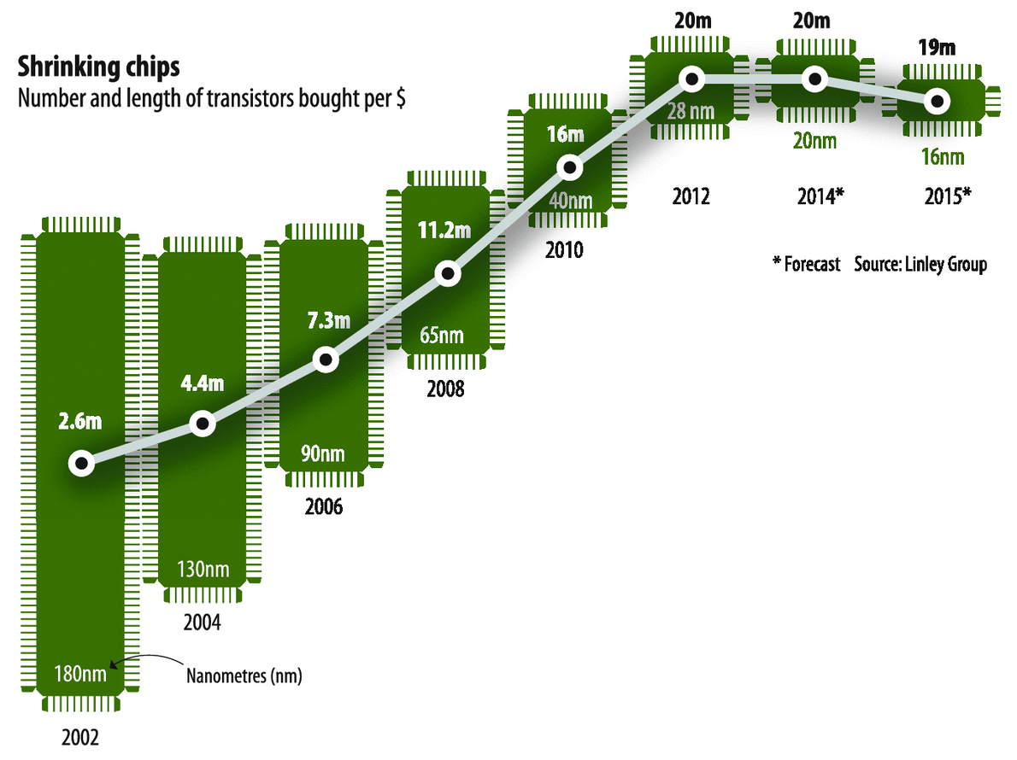
Limits
Dennard scaling grinding to a halt
28nm node may least expensive / area
The party isn’t exactly over,
but the police have arrived,
and the music has been turned
way down—Peter Kogge
There are several nodes left, BUT
“Capital costs are rising far faster
than revenue”—ROI the limiter
By 2016 est. new fab cost $8-10 billion
ITRS 2030 3.8nm
Scaling might end between 2021 and 2030
Other technologies will have to take over—radical change or evolutionary?
3D may help—cost still an issue / one time improvement
Limits have been proposed based on many different models
  Thermal / Electrodynamic / Quantum—to name a few
  They suggest we are orders of magnitude from physical limits of power or size
Notes:
According to Dennard scaling transistor dimensions are scaled by 30% (0.7x) every technology generation, thus reducing their area by 50%. This reduces the delay by 30% (0.7x) and therefore increases operating frequency by about 40% (1.4x). Finally, to keep electric field constant, voltage is reduced by 30%, reducing energy by 65% and power (at 1.4x frequency) by 50%.[note 3] Therefore, in every technology generation transistor density doubles, circuit becomes 40% faster, while power consumption (with twice the number of transistors) stays the same.
Fab for logic
International Technology Roadmap for Semiconductors

Slide 17
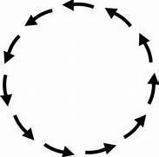
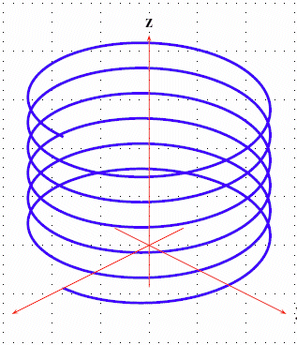
What Can Computer Architects Do To Help?
What we’ve always done:
  caching
  prediction / speculation
  pipelining
  parallelism
  indirection / virtualization
  specialization
Looks like we’re going in circles with
the same-old-same-old
My thesis is: as technology improves
we have to reapply the above six techniques
to take advantage of those improvements
It you add a 3rd dimension
to represent the change due to technology
what was a circle that goes nowhere
becomes a spiral of progress

Slide 18
Thank You

